Slide 1


Presentation on Youtube Transcript Summarizer
Guided By: Presented By:
Prof. Ankita Agrawal Aditi Modi
Aditi Tiwari
Himanshu Patidar
Sejal Bhawsar

Slide 2
Contents
Introduction
1.1 Overview
1.2 Purpose
Requirement Engineering
2.1 Requirement Collection
2.2 Functional Requirements
2.3 Non Functional Requirements
2.4 Use Case Diagram
Technical Design
3.1 Technical Architecture
3.2 Sequence Diagram
3.3 Class Diagram
3.4 DFD
User Interface Design
Data Design
5.1 Schema Design
5.2 E-R Diagram
REFERENCES

Slide 3
1. Introduction
1.1 Overview
Objective: Provide concise summaries of lengthy YouTube video transcripts, improving accessibility with visual representation and alternative summaries.
Functionality: Accepts a YouTube URL, retrieves the transcript, processes it using algorithms, and generates a concise summary.
Technology Stack: Built with HTML, CSS, JavaScript (frontend), Python (Flask/Django or Node.js backend), BeautifulSoup for web scraping, and PageRank algorithm.
Use Case: Helps students, professionals, and researchers quickly extract key points from video lectures, tutorials, or presentations.
1.2 Purpose
Quick Content Insights: Extract key points from lengthy videos, saving significant time for users.
Enhanced Research Efficiency: Enable professionals and students to gather information from multiple video sources quickly.
Content Accessibility: Provide summaries for individuals with hearing impairments or those in low-bandwidth environments.
Better Decision-Making: Help users decide the relevance of a video without watching the entire content.
Let me know if you'd like more focused examples!

Slide 4
2. Requirement Engineering 2.1 Requirement Collection
Summary of Tools/ways used to collect the reequipments.
Google Forms and Surveys: Collected responses from users to understand their expectations and challenges with summarizing YouTube transcripts.
User Discussions: Had casual conversations with students and professionals to learn about their problems with lengthy video content.
Research on Similar Tools: Explored existing transcript and summarization tools to identify useful features and common limitations.
Feedback from Prototypes: Shared early ideas with users to gather practical feedback.

Slide 5
2.2 Function Requirements
Transcript Extraction: Retrieve the full transcript of a YouTube video based on the URL provided by the user.
Summary Generation: Process the transcript to create a concise and accurate summary using various algorithm
3.Data Visualization: Provide visual representations, such as word clouds, sentiment analysis charts, or keyword frequency graphs.
User Interface: Provide an interactive and easy-to-use interface for inputting URLs and viewing results.
Export Options: Allow users to download the transcript, summary, or visualizations in formats like PDF or PNG.
Error Handling: Notify users if the video lacks a transcript or if the URL is invalid.
Would you like to add or modify anything?

Slide 6
2.2 Non Functional Requirements
The Non Functional Requirements.
Performance: The system should process and summarize transcripts within a few seconds for optimal user experience.
Scalability: The application should handle multiple requests simultaneously without performance degradation.
Usability: The interface should be simple, intuitive, and user-friendly to ensure ease of use for all users.
Reliability: The system should function consistently, providing accurate summaries and visualizations without errors.
Portability: The application should be accessible on different devices and browsers.
Security: User input data (e.g., video URLs) must be handled securely without compromising user privacy.
Maintainability: The system should be easy to update and maintain for future improvements or bug fixes.

Slide 7
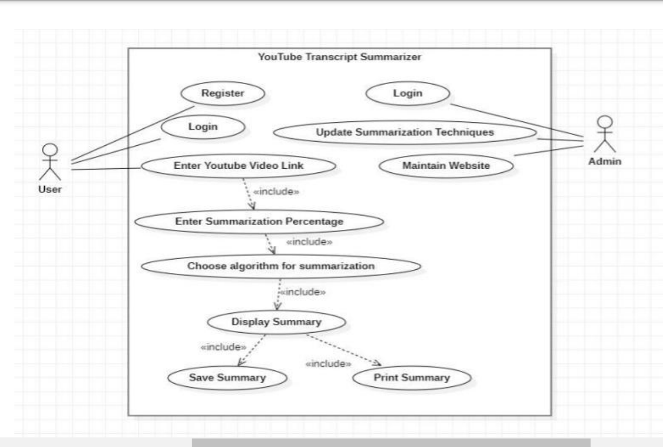
2.3 Use Case Diagram
System Use Case Diagram For Youtube Transcript Summarizer.

Slide 8
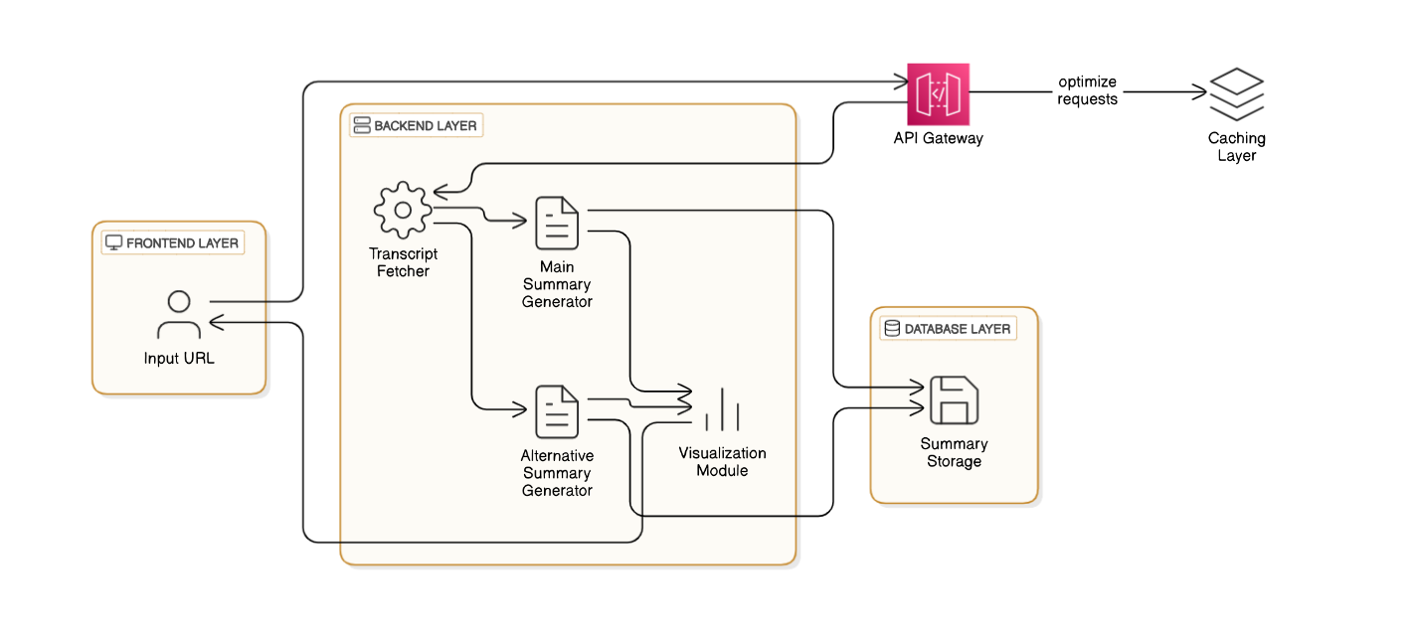
3. Technical Design 3.1 Technical Architecture

Slide 9
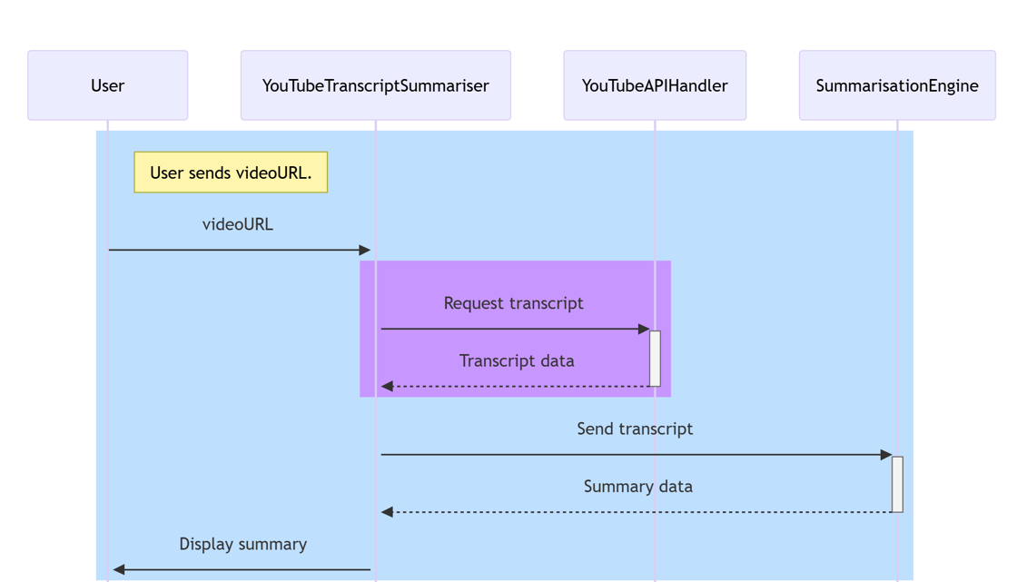
3.2 Sequence Diagram
System Sequence Diagram

Slide 10
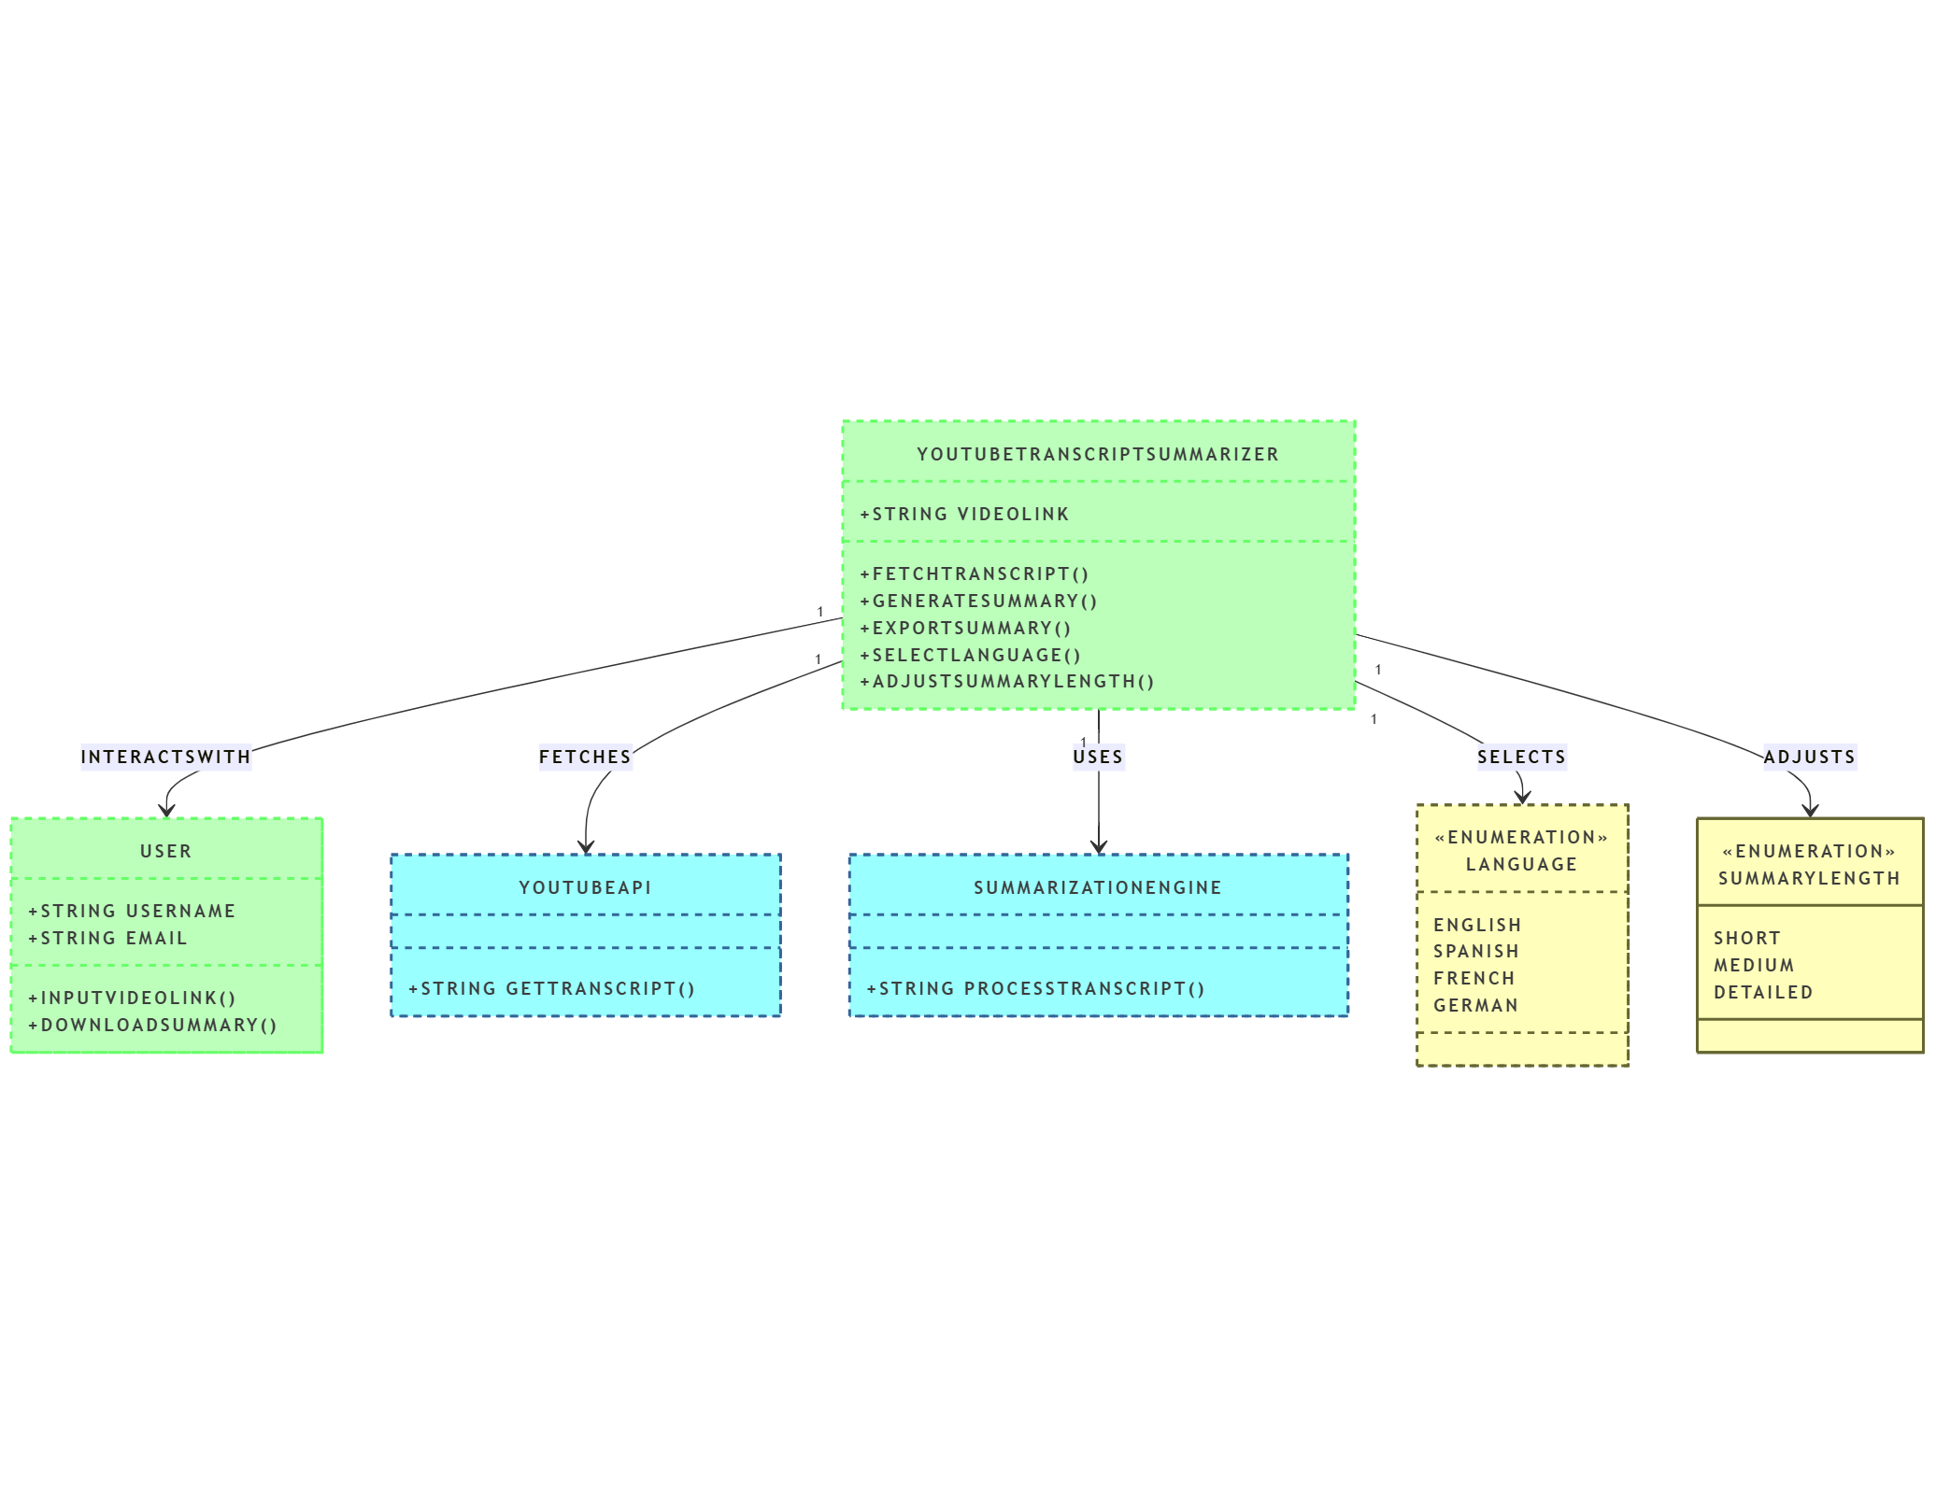
3.3 Class Diagram
System Class Diagram

Slide 11
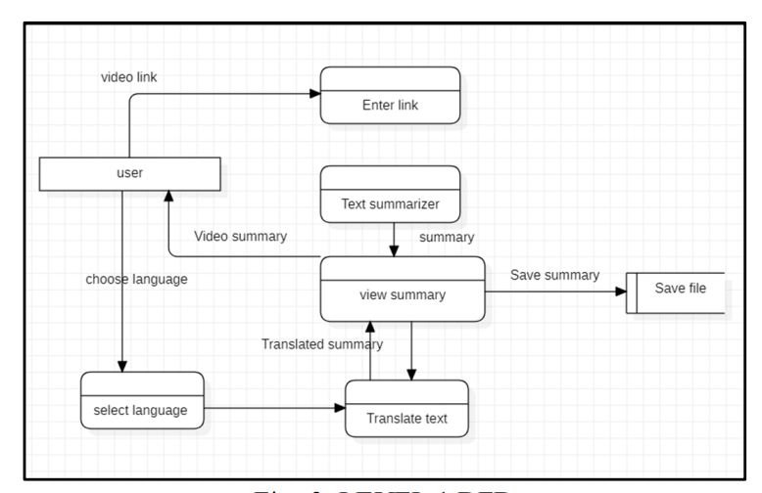
3.4 DFD
DFD Diagram

Slide 12
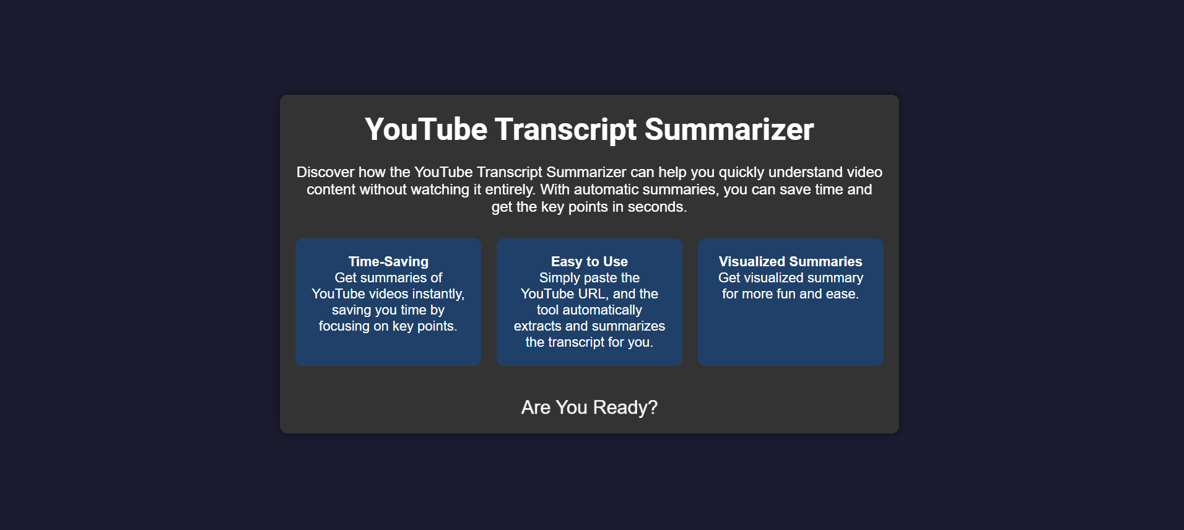
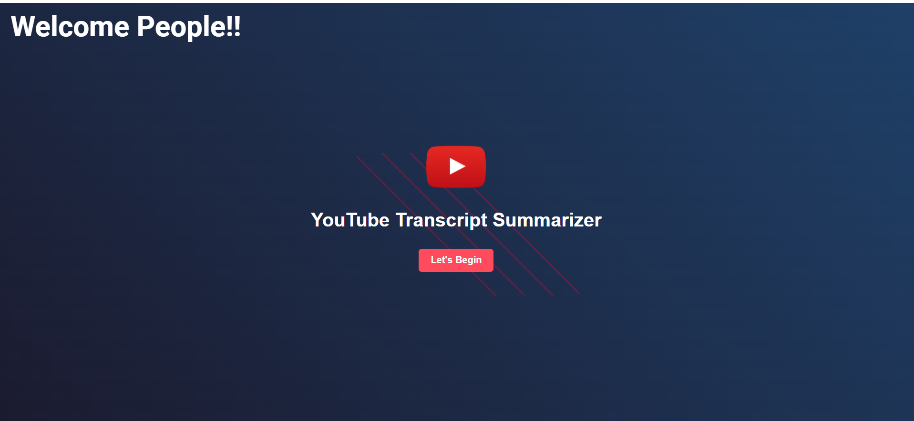
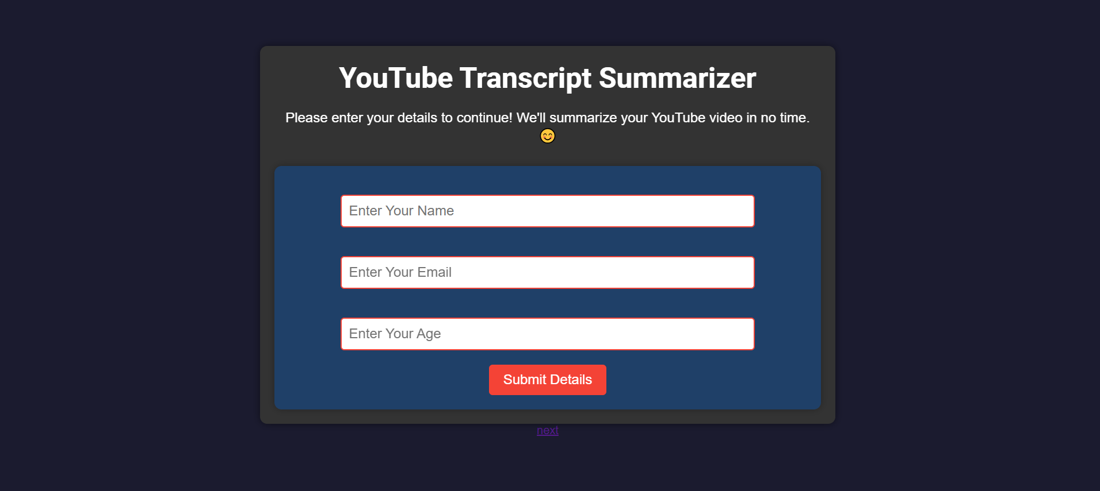
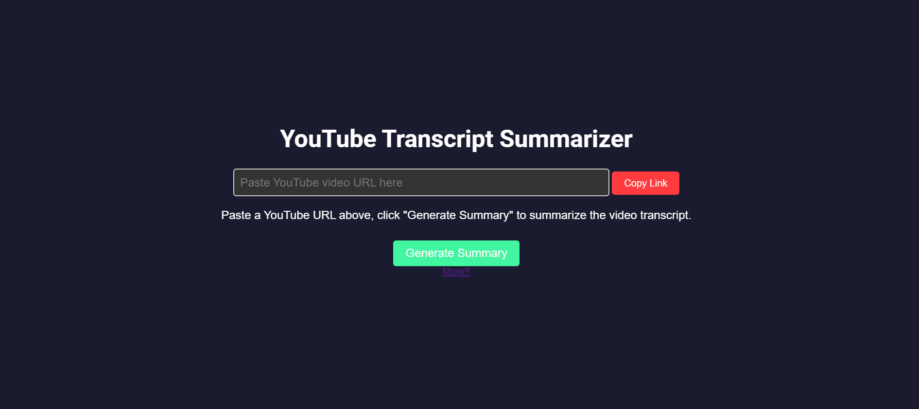
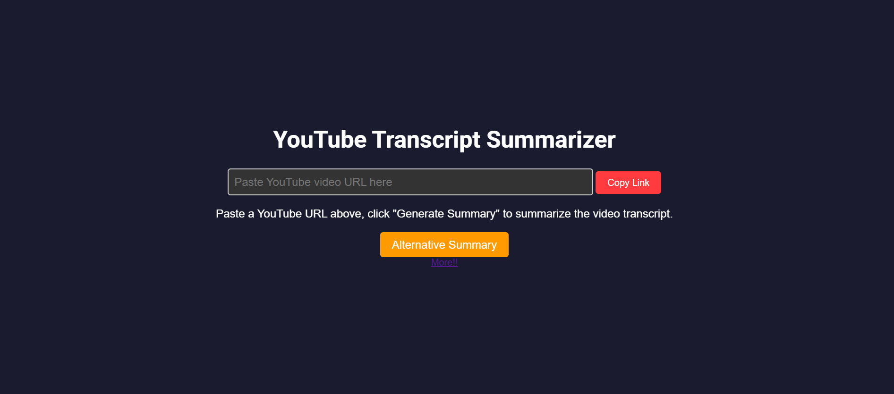
4. User Inface Design

Slide 13
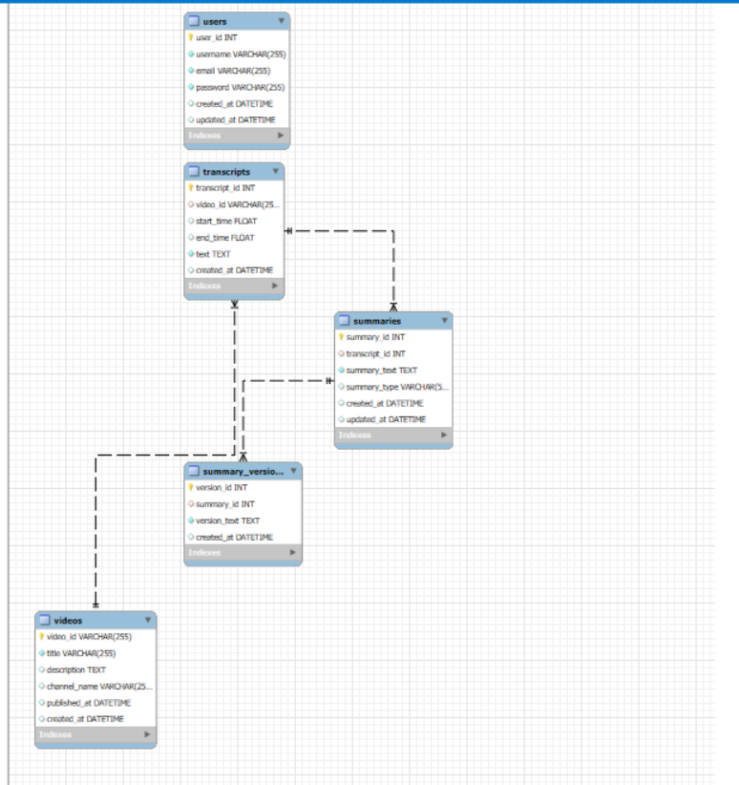
4. Data Design 4.1 Schema Definition
Complete Database Design.

Slide 14
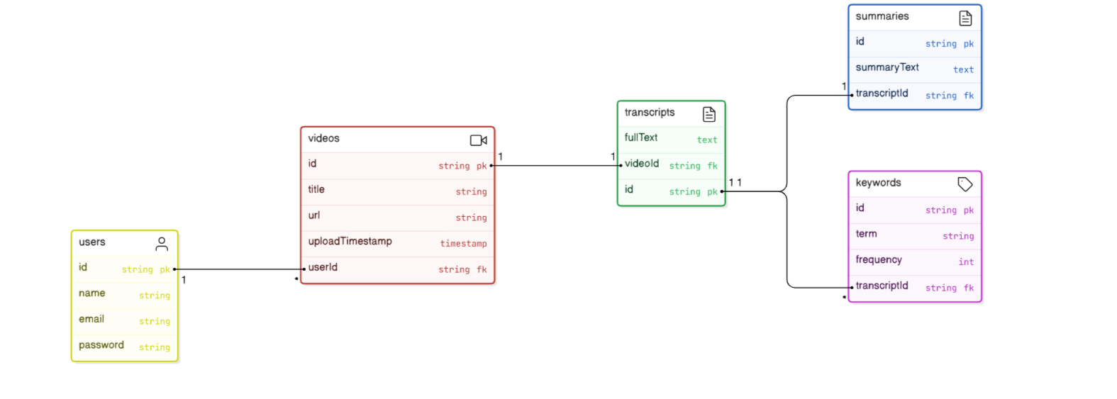
4.2 E-R Diagram

Slide 15
GitHub Link
https://github.com/Adititiwari169/YouTube-transcript-summarizer-
https://github.com/Himanshupatidar2005
https://github.com/Sejalbhawsar26
https://github.com/Aditimodi21

Slide 16
REFERENCES
Book o Natural Language Processing with Python" by Steven Bird et al. https://www.oreilly.com/library/view/natural-language-processing/9780596516499/ Text Analytics with Python" by Dipanjan Sarkar
https://link.springer.com/book/10.1007/978-1-4842-4354-8
Journal Article o Deep Learning for Natural Language Processing" by Jason Brownlee
https://machinelearningmastery.com/deep-learning-for-natural-language-processing/
Conference article o A Survey on Text Summarization Techniques https://link.springer.com/article/10.1007/s10462-020-09871-z https://link.springer.com/article/10.1007/s10462-020-09871-z
Website
https://machinelearningmastery.com/deep-learning-for-natural-language-processing/ https://developers.google.com/youtube/v3 https://link.springer.com/article/10.1007/s10462-020-09871-z

Slide 17
Thank You
Queries ?

